Slide 1


Final Week Project: RentATree Company
Robert Harding, Umaan Ijaz, Mhairi McDonald , Ella Kaderkutty, Kelly Taylor

Slide 2


Presentation Overview
Introduction
Week plan/overview
Client feedback deliverables
MoSCoW table review
Demo
Data Analysis
Design (Technical aspects)
Component Diagram
ERD
Class Diagram
Good coding practices
Evaluation
What went well
Reflections

Slide 3
Client Side Presentation

Slide 4
MONDAY - THURSDAY
Monday
Scoping and Organising
Briefing of specification
Tuesday - Wednesday
Development and Testing
Browse and search stock
Thursday
Final development
Prepare for first client meeting
Login/logout facility
Adding and updating basket
Data analysis report
Testing
Demonstration preparation

Slide 5
Client Feedback Deliverables
Multiple orders to one customer
Price per day rather than total
Amazon like experience – drop down menu/check boxes when searching rather than free text search
Clear and user friendly interface
Hash passwords
Notes:
Amazon like experience
Multiple orders to one customer
Hash passwords
Slick looking website – not old fashioned (2018 not 1980)
Drop down for search or check boxes
Price per day – not total price
Doesn’t want free text search – select type of search – amazon
All in stock products should be listed not groups together
Multiple orders to one customer
Hash passwords
Price per day rather than total
Amazon like experience – drop down menu/check boxes when searching rather than free text search
All in stock products should be listed not grouped together – want them grouped on type – same type then group by approx. height.
Slick looking website – not old fashioned

Slide 6
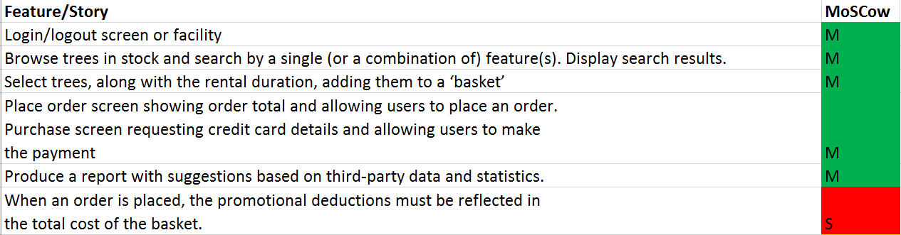
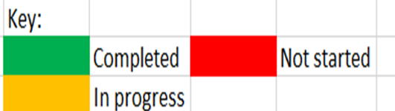
MoSCoW Table Review

Slide 7
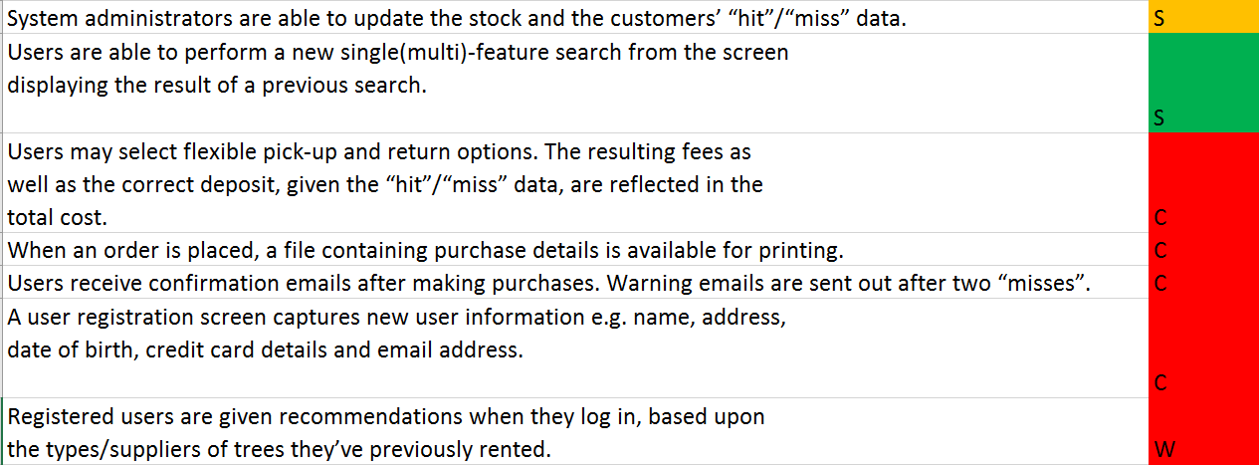
MoSCoW Continued..

Slide 8
Demo

Slide 9
Data Analysis

Slide 10
Data Analysis Report – What’s Included?
Created a hypothesis
Primary Research – face-to-face interviews
Secondary Research – Analysing reports and articles
Conclusions
Suggested improvements to website

Slide 11
Hypothesis:
“There is a positive correlation between retail ecommerce and sale of artificial trees”
Null:
“There is no correlation between retail ecommerce and sale of artificial trees”

Slide 12
PRIMARY RESEARCH
50% of people who chose artificial also said they would buy their trees online
Real trees were the most popular choice
KEY FINDINGS
Potential bias
Decisions would be influenced if they had more information about the impacts
Notes:
The reasons for choosing fake trees were mostly due to ease. For example, the needles don’t fall off, pets don’t eat the needles. Also health and safety reasons, so some believed that they were less likely to set on fire – which would be important for any clients but especially those buying for public buildings.
Some people believed that it was actually more eco friendly to purchase a fake tree rather than a real tree.
Many people realised that their original decision of choosing a fake/real tree would be influenced if they were more aware of their impacts.
There is potential bias in this data as the sample size was very small compared to the total number of people that purchase Christmas trees.

Slide 13
Key Findings
SECONDARY DATA
Mixture of US and UK data.
In the US 25-30 million real trees are sold each year.
UK – 6-8 million trees sold per year.
Notes:
Concentrated on US data as there was more, however took into consideration UK data when coming up with our suggestions.
However, in the US, they have Christmas tree farms (Pine, Fir, Spruce) in which have 350 million trees growing (helps to replace the trees that are felled) – keeps air clean and also provides habitats for wildlife
2m was the average househole size of a tree.
At £80 a tonne this would work out to be £720,000 a year – could be spent on other important issues.

Slide 14
Ecommerce value of US retail sales ($ billions)
SECONDARY DATA
$267.82 billion increase
Source: Statista – shows ecommerce value
Notes:
- 11 year period

Slide 15
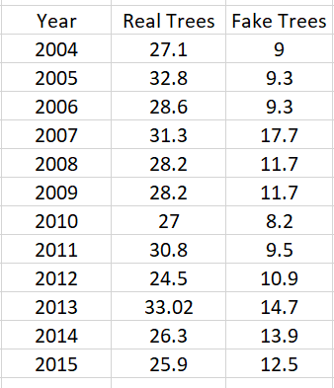
Sale of Christmas Trees (millions)
SECONDARY DATA
Christmas trees sold in millions
Source: Statista – shows sales of Christmas trees in millions
Notes:
This data shows the change in Christmas tree preference in terms on real and artificial trees.
By looking at this data it is clear to see that there is an increase in the sale of artificial trees, however there hasn’t been a significant increase or decrease in the sale of real trees so this tells us that there has just been an overall increase in tree sales.

Slide 16
Scatter Graph To Show The Correlation
= REAL
= FAKE
Notes:
Clear positive correlation between ecommerce value and artificial Christmas tree sales
We were also able to plot and see that there is a negative correlation between the ecommerce value and the sale of real Christmas trees
Accept hypoth and reject null hypoth

Slide 17
Conclusion
Not the same level of ease of purchasing a real tree online
Need more awareness of impacts for informed decisions
Notes:
– this helped us to accept the hypoth and reject the null.

Slide 18
Suggested Improvements
Information Page
Promotions
Notes:
Info on how to take care of trees and their environmental impacts
Maybe increase promotions on real trees as their sales have decreased.
The website helps with that niche market of being able to purchase real trees with ease online so this in itself would improve the gaps we found in our research

Slide 19
Managerial Presentation

Slide 20
Design

Slide 21
The Component Diagram
User Interface
The layer the user/client interacts with
Top Layer
JAVA
The connector between the Top layer and Bottom layer, Includes algorithms such as calculating total basket
Middle Layer
SQL
Creates data and inserts into tables
Bottom Layer

Slide 22
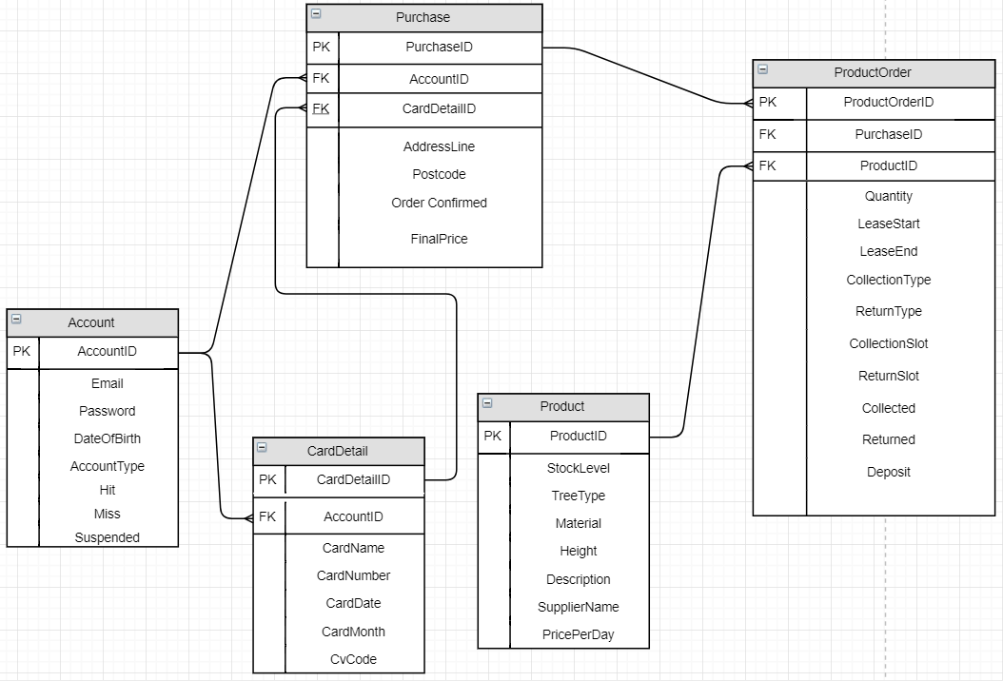
ERD
Notes:
Account can have many purchases
An account can also have many cards associated with it. - explain that it cannot be done as of yet but we have the java and sql implementation. It was a matter of getting the frontend working.
When a person buys an item it is put into the product order table alongside all the information it needs. It is also put alongside a purchase id.
If the person buys another item it will create another row in the product order table and then will be matched to the same purchase id as gthe last product order. This is what allows us to group all our orders together in one.

Slide 23
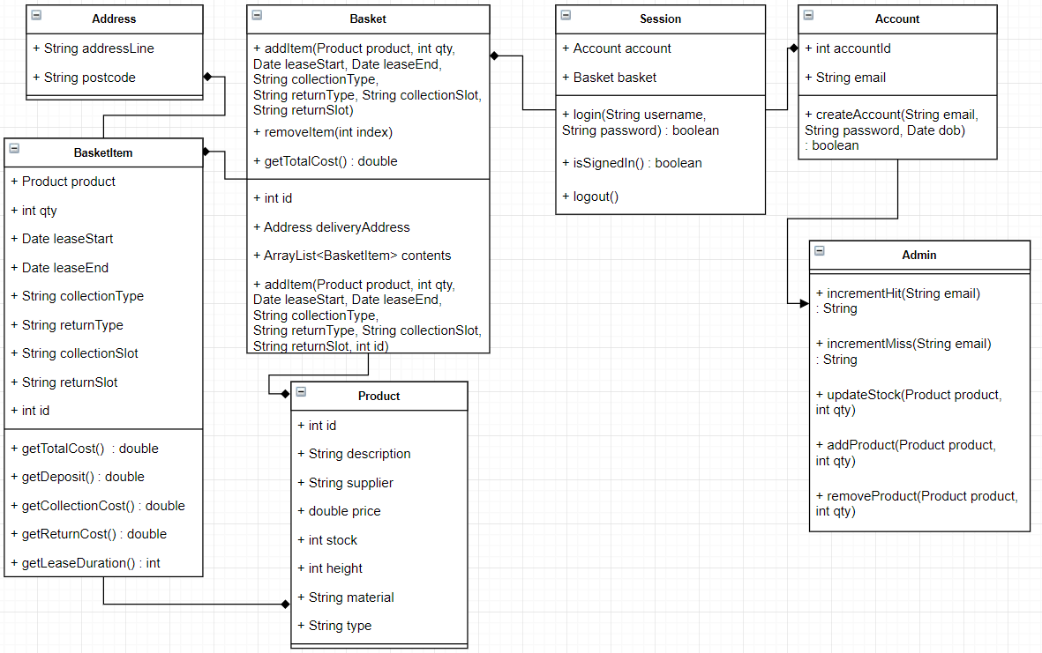
The Class Diagram

Slide 24
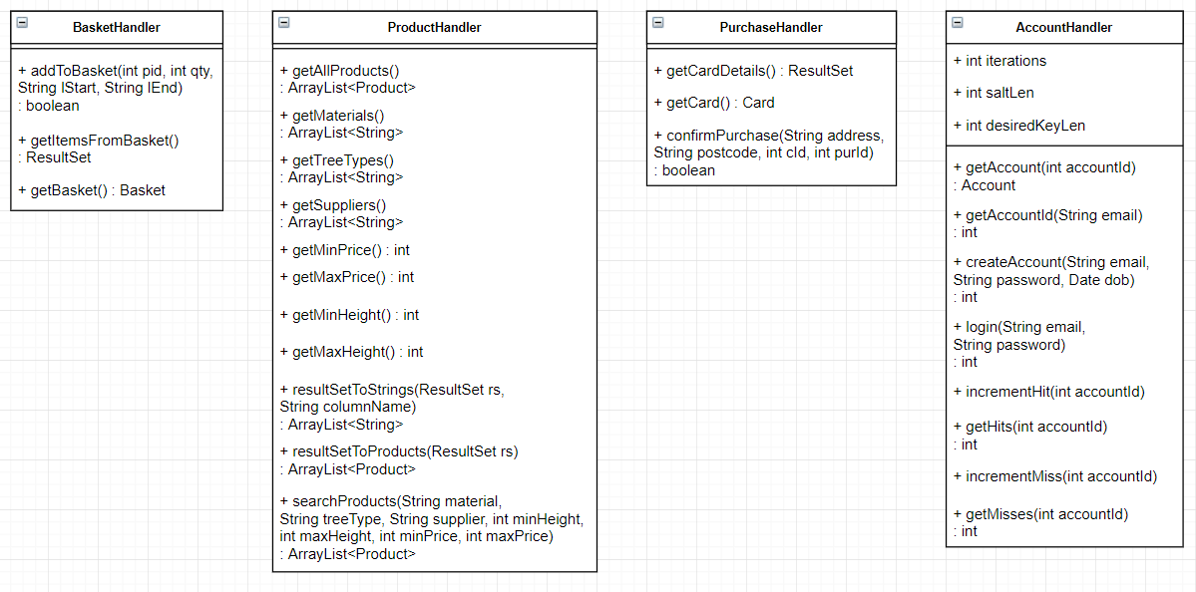
The Class Diagram Cont’d

Slide 25
Good Coding Practices

Slide 26
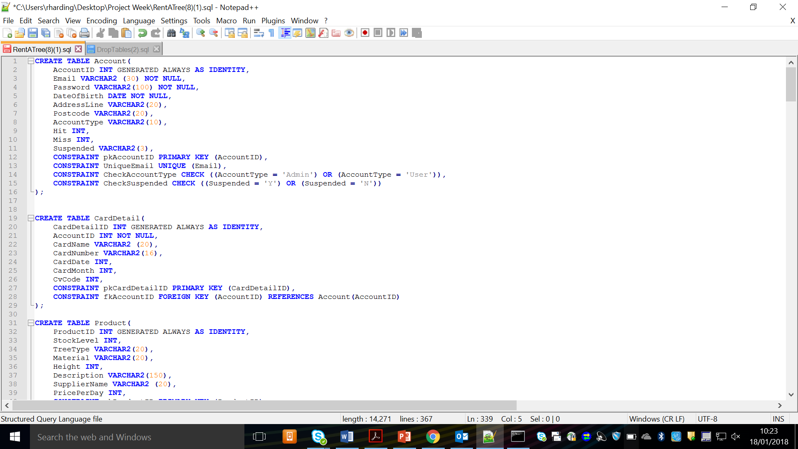
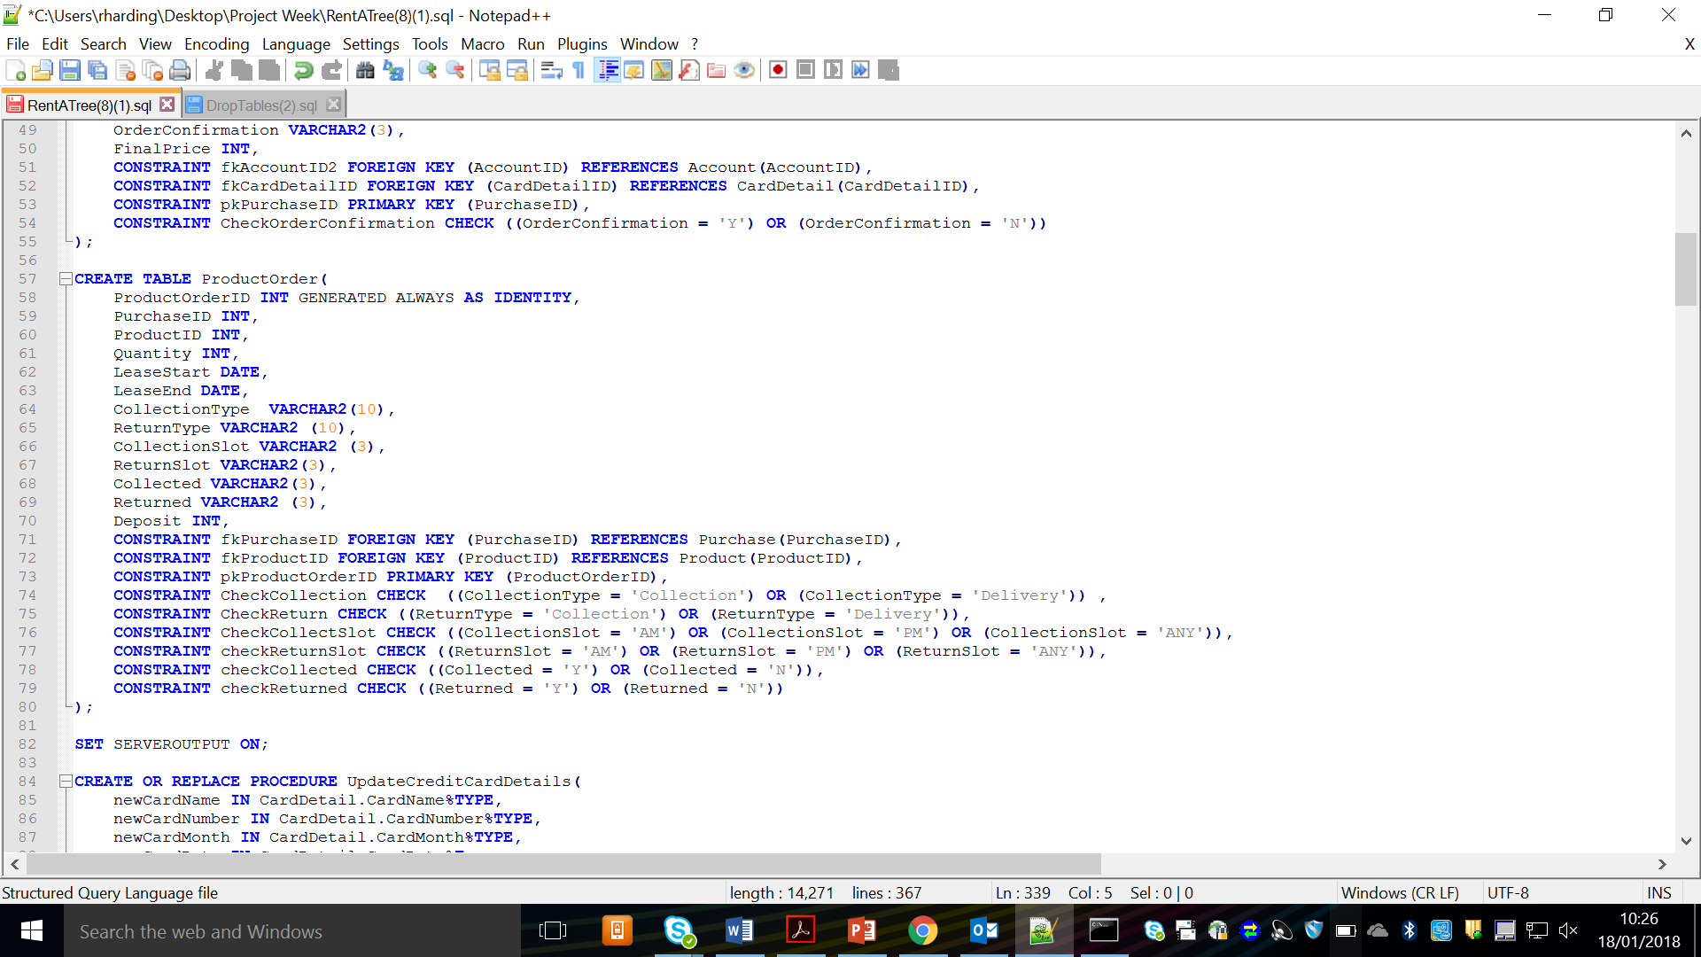
SQL
Capitalised Names
Checks for value
Checks for relation of tables
Notes:
We have some examples of good coding practice that we implemented.
- Capitalisation of the table name.
- NOT NULL - Checking if the values are null for attributes. This stops any human error or computational errors from allowing null data to be entered into the attributes
INT GEN – Ensures primary keys are automatically generated. Stop any error from happening if we had to enter data ourselves. Males the database more easy to use and consistent
- Primary and foreign key constraints to ensure that the connections for foreign keys are created.

Slide 27
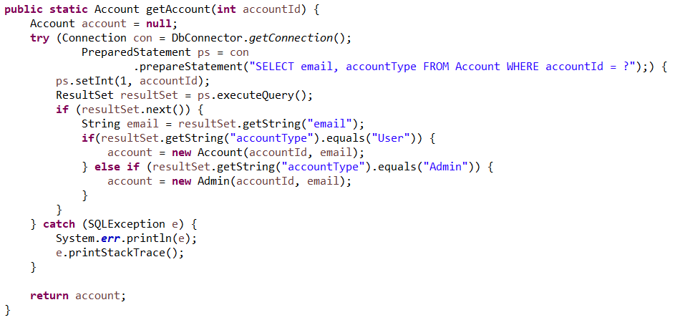
Try With Resource
Benefits:
Closes resources automatically so that we avoid memory leaks and human error.
More readable and easy to write

Slide 28
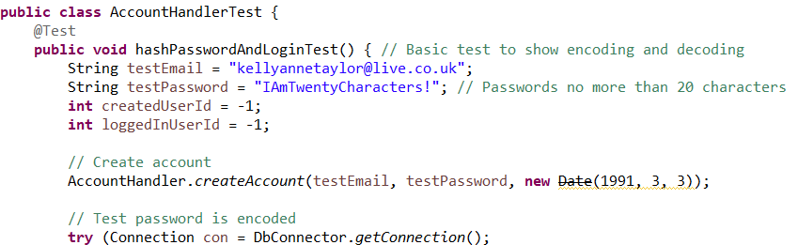
Unit Tests
Benefits:
Unit tests allow us peace of mind our code is working as expected
It provides security for altering the code in future, you can see quickly if you’ve broken existing code

Slide 29
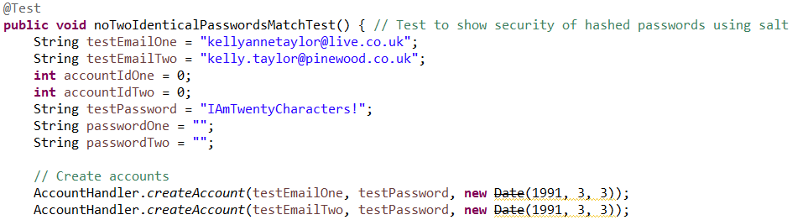
Unit Tests
We can run unit tests in isolation so we don’t need a front end for testing, they’re also quicker than manual testing (And more reliable)

Slide 30
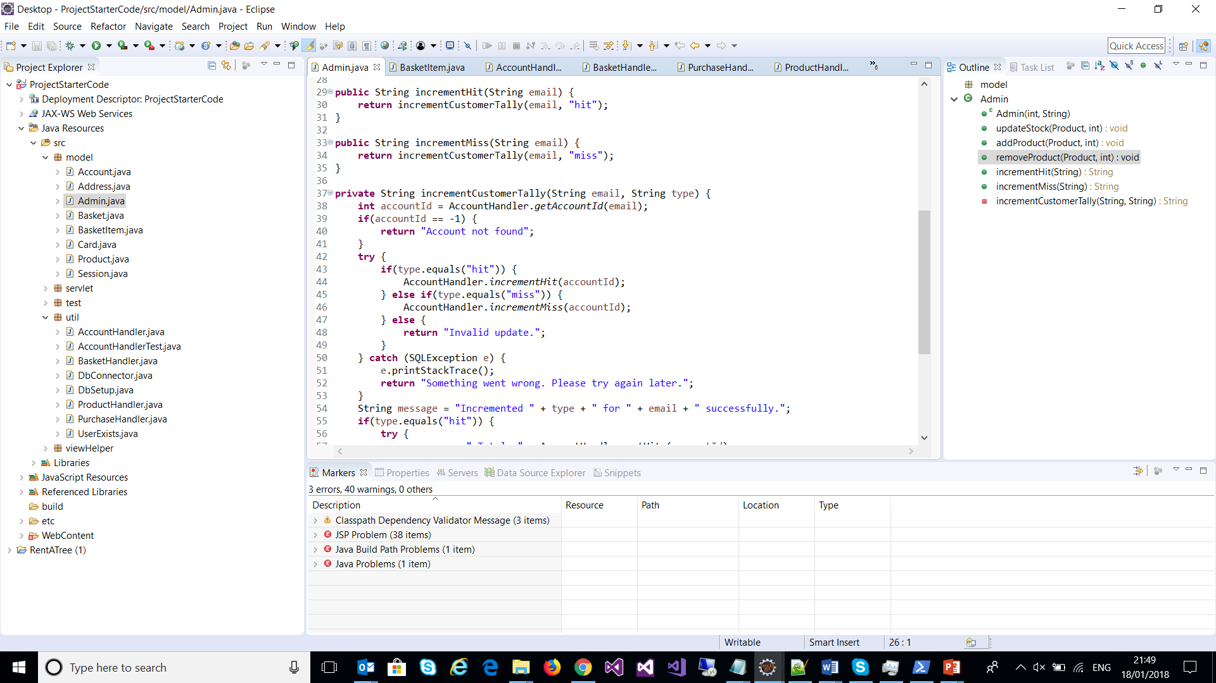
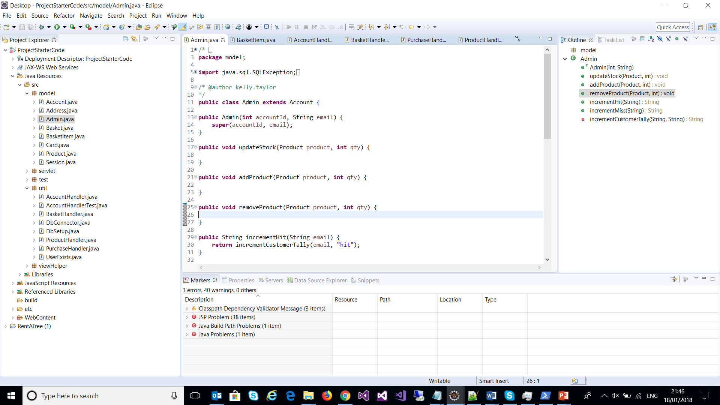
Code Reuse/Helper Methods
Avoids code duplication
Hides complexity
Allows ‘child’ classes to reuse all of their parents code and have their own ‘characteristics’
Subclasses/Inheritance

Slide 31
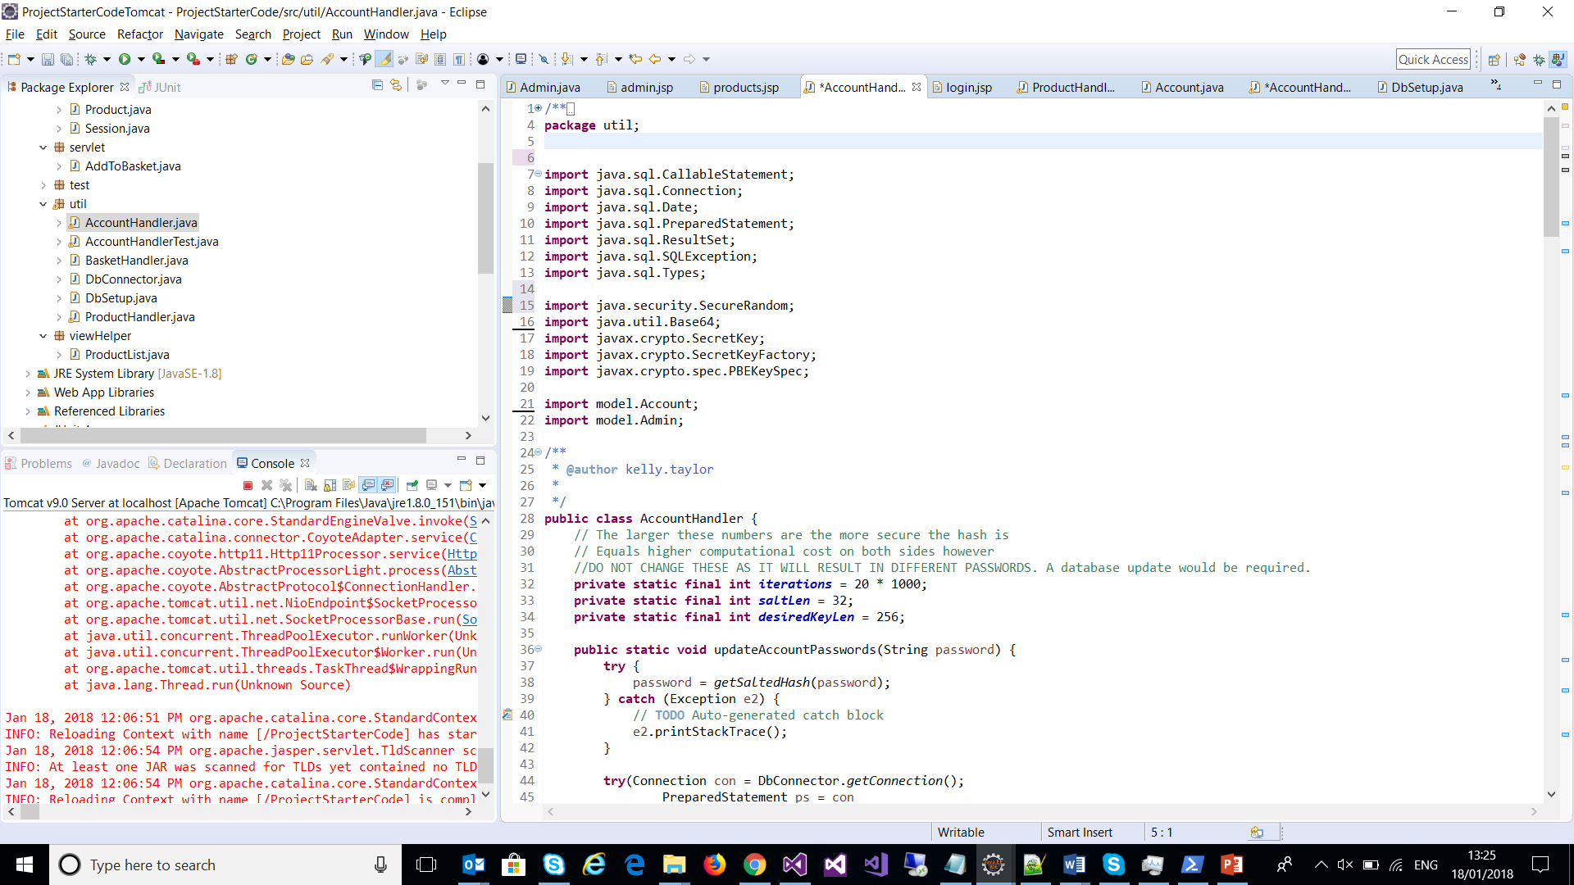
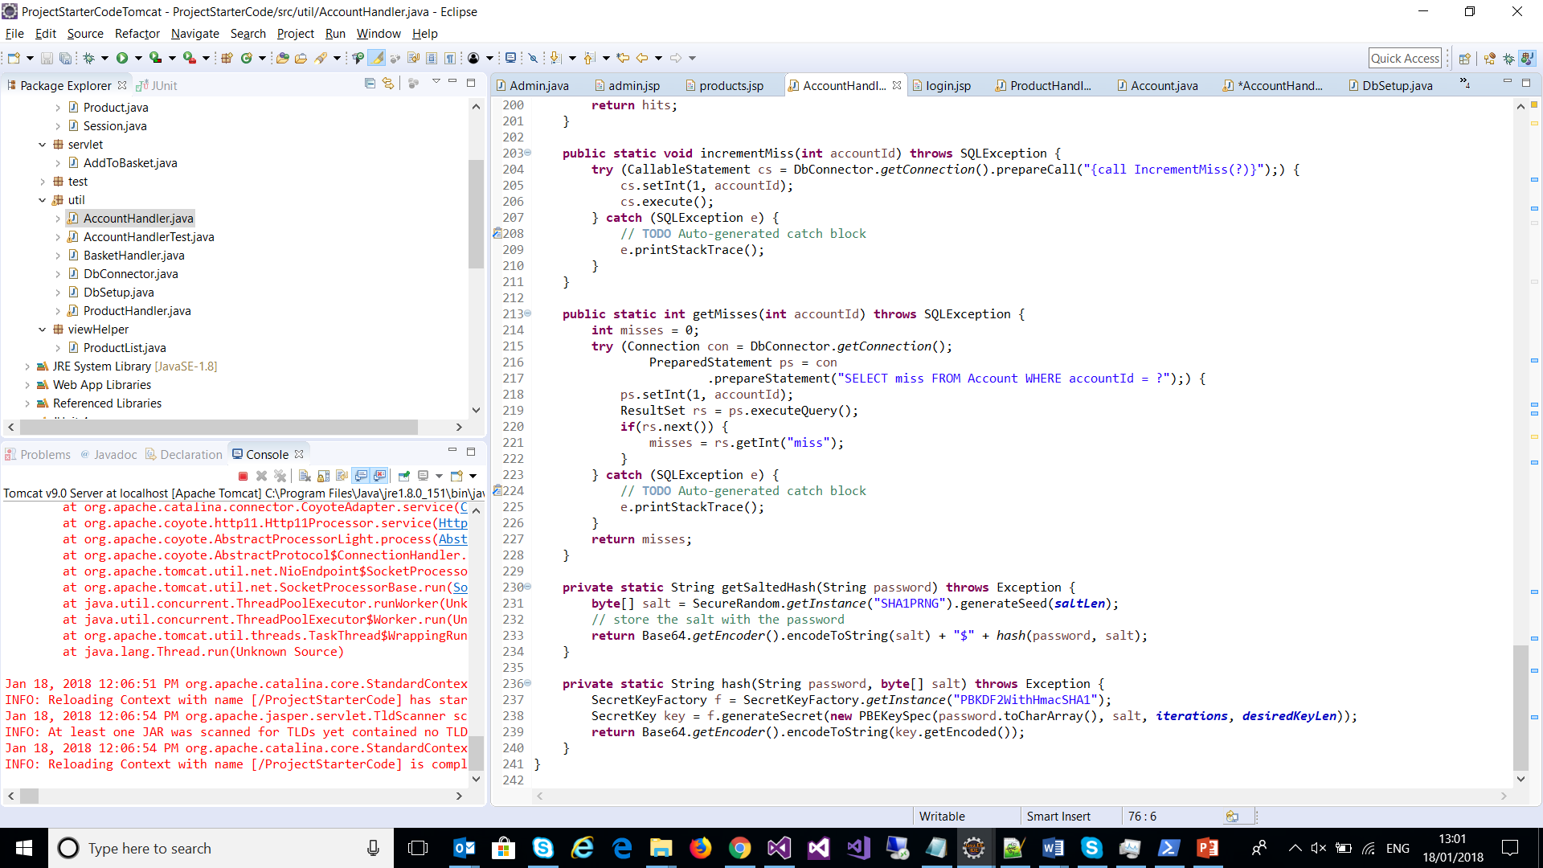
Utilising java security/crypto
Benefits:
By utilising the java security/crypto classes we avoid the need to write our own security/hashing code and use what java has provided

Slide 32
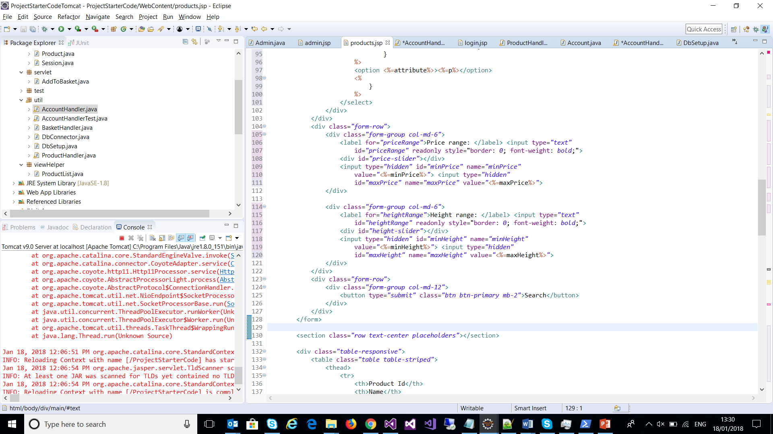
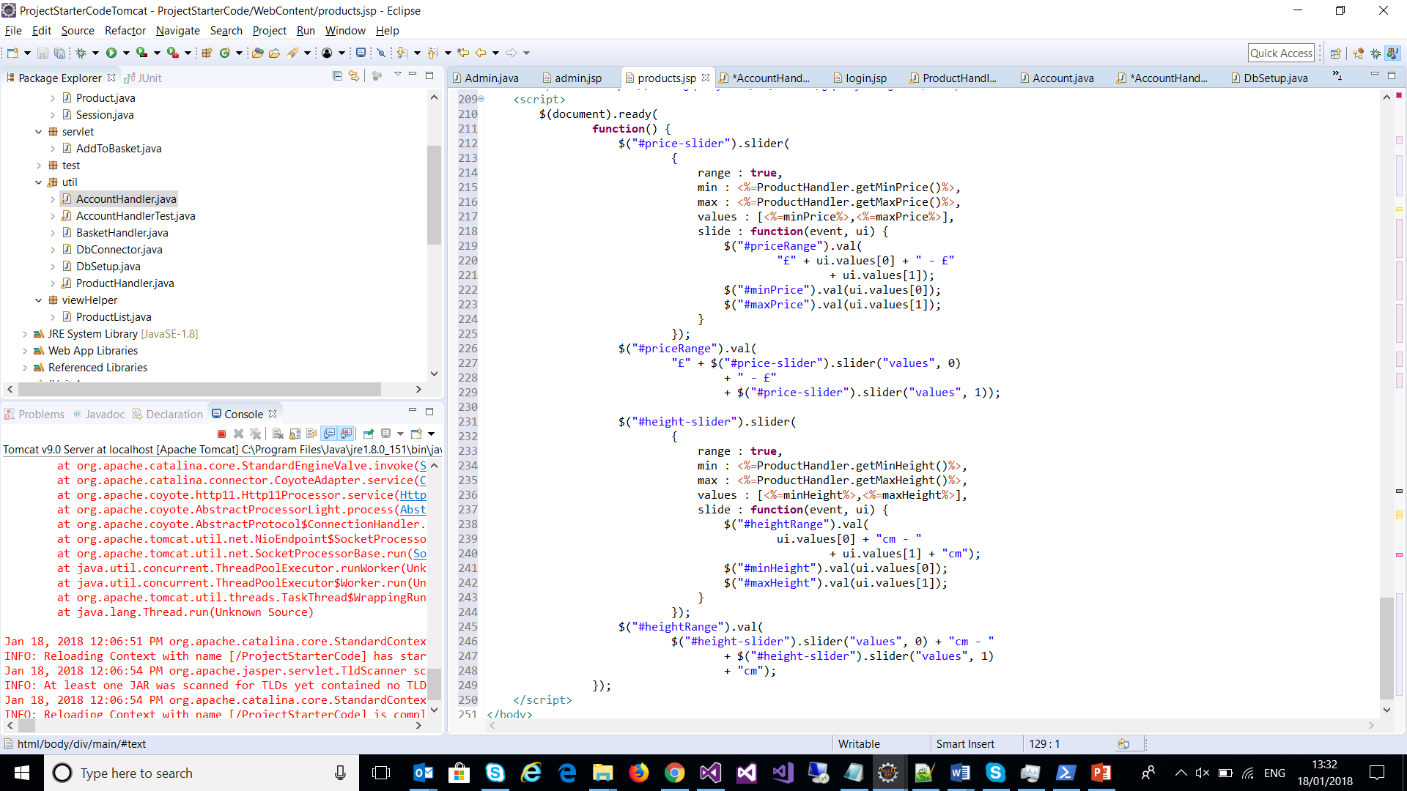
jQuery UI Slider
Benefits:
By making use of the Jquery UI Slider we’ve avoided needing to create our own multi handle slider (HTML5 provides a single handle slider)

Slide 33
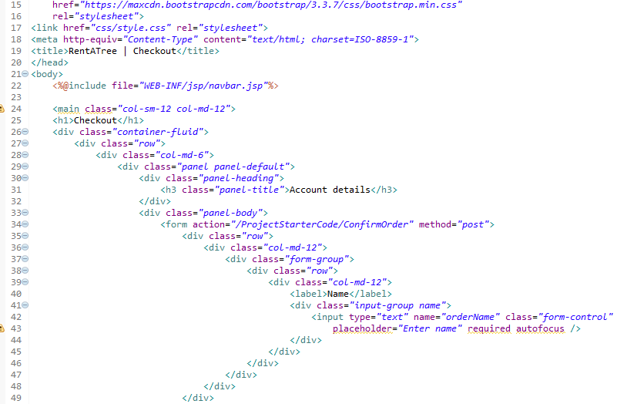
Front-End
Bootstrap helpers
Appropriate indentation
Semantic names

Slide 34
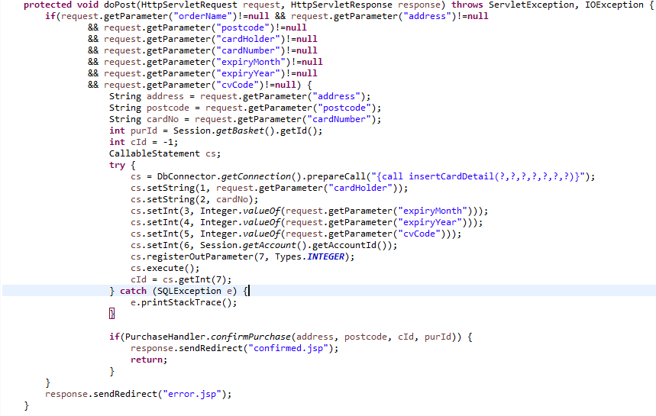
Front-End Cont’d
Outsourcing specific tasks to Servlets and Handler classes
Separating HTML and Java middleware
Providing a clear and reusable link between the SQL back-end and the HTML/CSS/JS that forms the UI

Slide 35
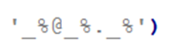
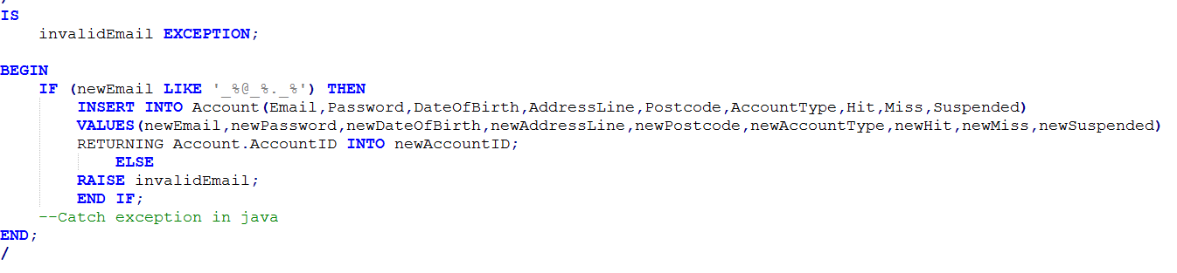
Exception Handling (SQL)

Slide 36
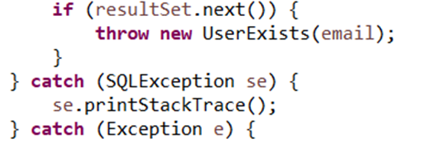
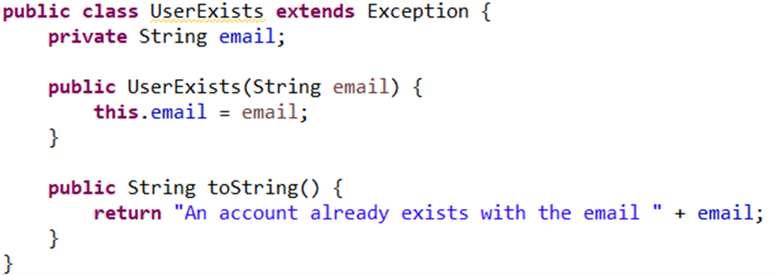
Exception Handling (JAVA)
Benefits:
Exception handling allows us to react to something that has gone wrong that was not expected. By knowing what this is it allows us to respond in an appropriate manner (i.e. we can provide the failure in a user friendly manner, or how the code does what it needs to)
Custom exceptions give us the ability to provide good exception information by providing the relevant details. By having relevant exceptions it also makes them easy to distinguish and understand what’s happened at a glance.

Slide 37
Evaluation

Slide 38
Evaluation and Reflection
What we found hard
Finding reliable report data
Managing client expectations
What went well?
Delegated tasks to each team member based on skills
Communication
Completed the Must tasks
Notes:
• Which bits of the exercise did you find easy/hard and why?
• What went well?

Slide 39
Evaluation and Reflection
What would you do next time?
Focus more on basic requirements
Do more TDD
Improve maintainability of HTML and JAVA
File/task management
Given more time what would you do to improve?
Work on completing more of the MoSCoW table
Notes:
What went badly?
• What would you do differently next time, in terms of process?
• Given more time what would you do to improve your solution?

Slide 40
Q & A

Slide 41
References
Statista
https://www.statista.com/statistics/209249/purchase-figures-for-real-and-fake-christmas-trees-in-the-us/
Telegraph, By Naomi Slade, 30 Nov 2014
http://www.telegraph.co.uk/gardening/gardeningadvice/11259120/Christmas-trees-are-they-really-sustainable.html
Guardian, Adam Vaughan, 3 Nov 2014
https://www.theguardian.com/environment/2014/jan/03/christmas-tree-recycling-london
Envirowaste, 11 Dec 2014
https://www.envirowaste.co.uk/blog/articles/christmas-waste-statistics-making-christmas-green/
Woodland Trust, Emilie Bonnevay, 6 Dec 2016
https://www.woodlandtrust.org.uk/blog/2016/12/green-christmas-tree/

